Slide 1
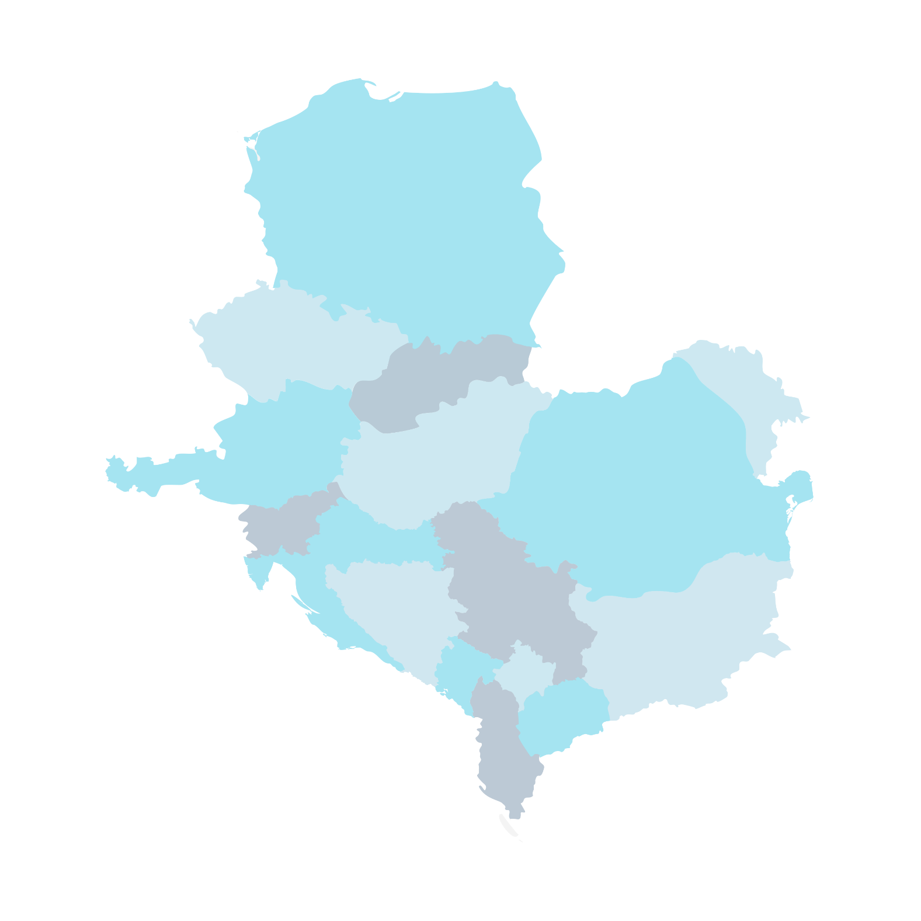
CEEPUS CENTRAL EUROPEAN EXCHANGE PROGRAM FOR UNIVERSITY STUDIES Study in Central Europe or in the Western Balkans!

Slide 2
Why
CEEPUS?
simple application
international experience nearby
courses in English, German, etc.
exciting summer schools
study period fitting to your own curriculum
opportunity to do research
short term mobility
available from non-EU countries
networking

Slide 3
CEEPUS is an excellent opportunity for all!
”The period I spent abroad helped me a lot, it gave me a routine. I have been using the language much more boldly, since then. That was my main goal with the trip, to practice the language.”
Lilla, Slovakia
”Despite the different worldviews in each country the region has a common history.Thanks to the CEEPUS scholarship the Central European identity has strengthened in me.”
Bence, Romania
”It was important to have an experience abroad that I could include in my CV. But the most important thing for me was to gain life experience.”
Benjamin, Croatia

Slide 4
CEEPUS
in numbers
28 Hungarian universities take part in networks
120 international networks in all fields of study
more than 25 years
16 countries in Central Europe
10 months per study cycle

Slide 5
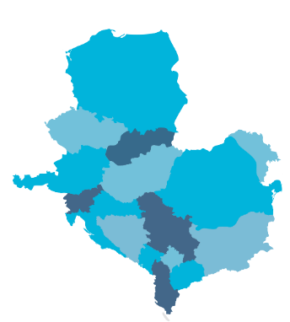
You can apply for
study period (3-5 months)
research related to the thesis/dissertation (1-2 months)
summer school (min. 6 days)
short term excursion (min. 3 days)
freemover, mobilities outside the networks

Slide 6
There is nothing left but to APPLY!
What do you need?
enrolled student status at the home university during the mobility period
2 completed semesters until the mobility period
nomination from both the home and host institutions’ network coordinator, in the case of network mobility
Important!
The call for applications is published by your home university. It also determines the selection criteria and then the potential candidates are selected by the local coordinator of the network. Applications are to be submitted via ceepus.info.

Slide 7
CEEPUS
firsthand information
IN PERSON
ONLINE
from your network/international coordinator
tpf.hu/english
ceepus.info

